Slide 1

Western Michigan University
CS 6100- Adv stor, ret, pro of big data
Attrition Prediction of IBM Employees
AND
Hadoop Movie Rating Counter with MR

Slide 2
Introduction
Employee attrition is the departure of skilled and experienced individuals from an organization, such as IBM.
The sudden loss of such valuable assets can be highly detrimental to an organization.
In this project, we employ Python, the Logistic Regression algorithm and ML to predict attrition.
Data analysis plays a pivotal role in our approach.
We identify parameters that are more likely to be associated with attrition and use data visualization techniques.

Slide 3
Data and Methodology
Data Source:
The data for this analysis was sourced from Kaggle.
This dataset was contributed by IBM employees for the evaluation of students.
It contains various columns, but we focused on specific ones such as attrition, job satisfaction, Distance from home, environment satisfaction, etc.
Method:
The project is implemented using python libraries such as pandas, numpy, matplotlib, seaborn, tensorflow, sklearn.
Supervised Machine Learning

Slide 4
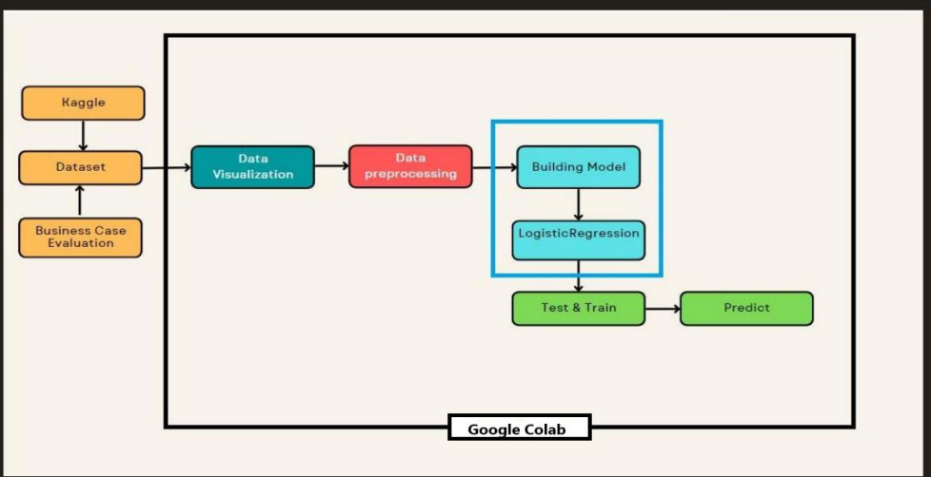
Architecture

Slide 5
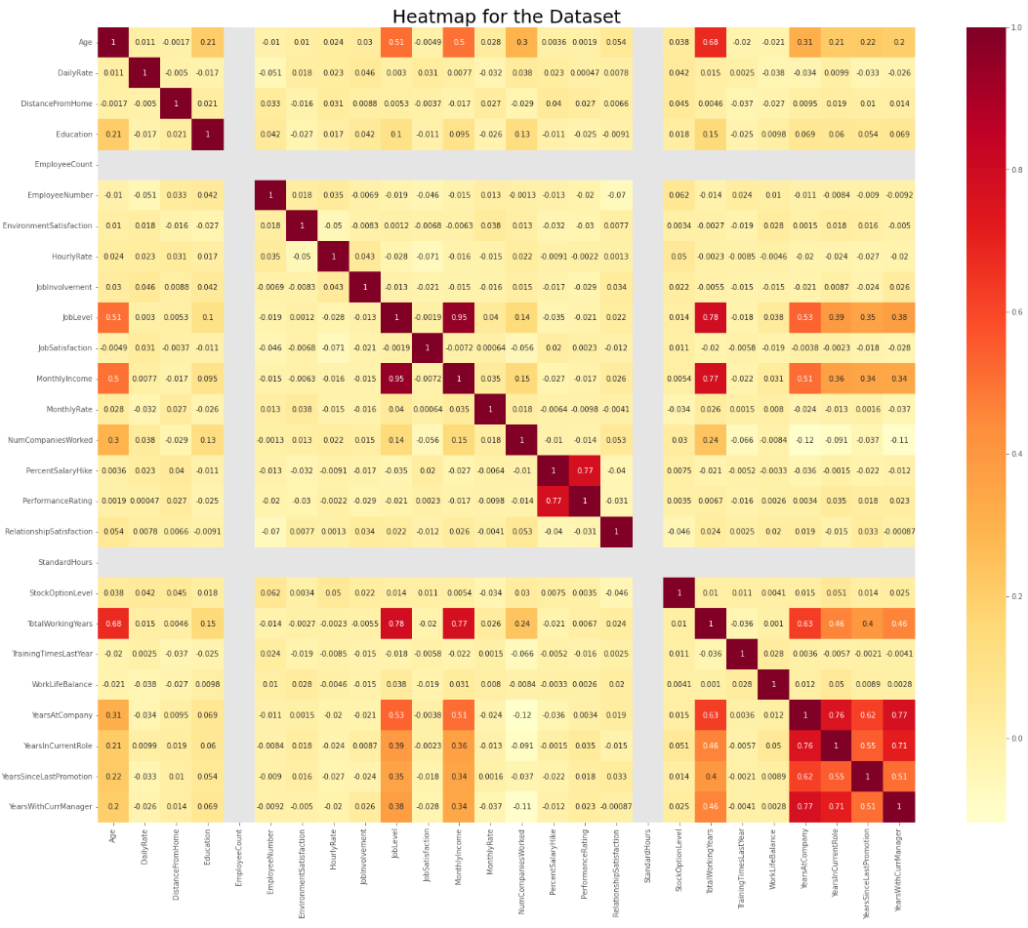
Data Visualization
Data visualization is done using heatmap representation for all the datasets

Slide 6
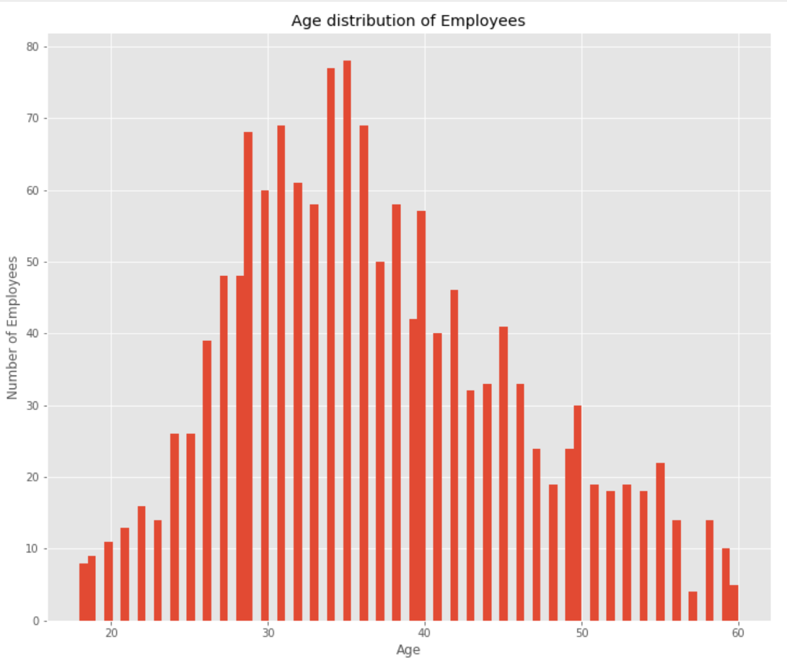
Graphical representation of age using matplotlib.pyplot

Slide 7
Modelling
We have used Supervised Learning using the Logistic Regression.
The following features were chosen based on their potential impact on attrition:
Factors:
Age
Department
Performance Rating
Total Working Years
Years at Company
Education
Monthly Income
Job Satisfaction

Slide 8
The Confusion Matrix
The confusion matrix is employed to provide a detailed breakdown of the model's predictions, including true positives, true negatives, false positives, and false negatives.
This matrix aids in understanding the model's strengths and weaknesses, especially in scenarios with imbalanced classes.

Slide 9
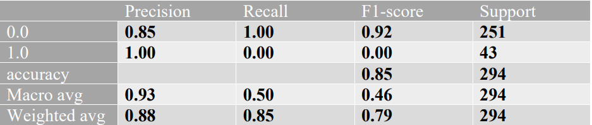
F1 Score

Slide 10
Applications and Conclusion
We provide the values to the attribute according to the parameters age, department, performance Rating, Total working years, Education, Education field, Years at company, Monthly Income, Job satisfaction. Different value predicts the overall result for attrition.
This project lays the groundwork for predicting employee attrition, providing valuable insights for organizational management.
Continued refinement and exploration are encouraged to evolve the model into a robust tool for proactive HR management.

Slide 11
References
N. Bhartiya, S. Jannu, P. Shukla and R. Chapaneri, "Employee Attrition Prediction Using Classification Models," 2019 IEEE 5th International Conference for Convergence in Technology (I2CT), Bombay, India, 2019, pp. 1-6, doi: 10.1109/I2CT45611.2019.9033784.
Killham, E. (January 25, 2022). Employee Attrition Analytics: The Who, When & Why Of Employee Turnover. Retrieved from https://blog.perceptyx.com/employee-attrition-analytics.
Hwang, & Chen, M. (2017). Big-Data Analytics for Cloud, IoT and Cognitive Computing. In Big-Data Analytics for Cloud, IoT and Cognitive Computing. John Wiley & Sons, Incorporated.
Erl, Khattak, W., & Buhler, P. (2016). Part I: The Fundamentals of Big Data. In Big Data Fundamentals. Pearson Education, Limited.
Erl, Khattak, W., & Buhler, P. (2016). Part II: Storing and Analyzing Big Data. In Big Data Fundamentals. Pearson Education, Limited.

Slide 12
And here we continue with the second one..
Hadoop Movie Rating Counter with MR

Slide 13
Introduction
Hadoop is built to handle massive amounts of data and can scale horizontally by adding more commodity servers to a cluster.
Hadoop is fault-tolerant, meaning it can continue to operate even if individual nodes in a cluster fail. It does this by replicating data across multiple nodes.
MapReduce is a programming model and data processing technique that was introduced by Google in a research paper published in 2004.

Slide 14
Data and Methodology
Hadoop provides a distributed computing framework that allows for the parallel processing of data using the MapReduce programming model.
We are using the data from The GroupLens Research Project which is a research group in the Department of Computer Science and Engineering at the University of Minnesota.
This data has 100k rating files:
u.data- user id, movie id, ratings, timestamp.

Slide 15
Problem 1. How many Movies per Ratings
User_id | Movie_id | Ratings | timestamp
821 | 151 | 2 | 2332
234 | 586 | 1 | 3452
231 | 345 | 3 | 3232
256 | 682 | 2 | 3232
982 | 981 | 3 | 9829
Mapping
2,1
1,1
3,1
2,1
3,1
Shuffle and sort
1->1
2->1,1
3->1,1
Reduce
1,2
2,2
3,2
In mapping , we take Ratings as the key
In shuffle and sort, we agrregate all by ratings.
Reducer will count all the 1s of each ratings

Slide 16
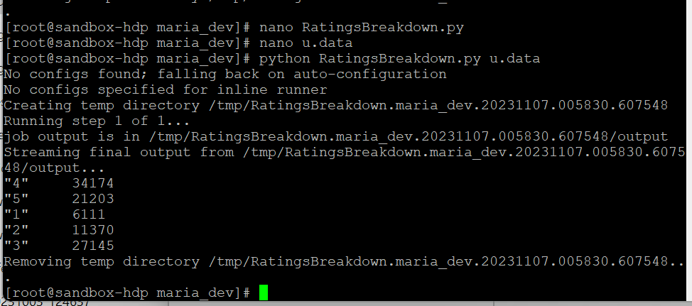
Mapper and Reducer
OUTPUT
def mapper_get_ratings(self, _, line): (userID, movieID, rating, timestamp) = line.split('\t') yield rating, 1 def reducer_count_ratings(self, key, values): yield key, sum(values)

Slide 17
Problem 2. How many Ratings per Movie (Which movie rated the most)
User_id | Movie_id | Ratings | timestamp
821 | 151 | 2 | 2332
234 | 586 | 1 | 3452
231 | 151 | 3 | 3232
256 | 682 | 2 | 3232
982 | 151 | 3 | 9829
Mapping
151,1
586,1
151,1
682,1
151,1
Shuffle and sort
151->1,1,1
586->1
682->1
Reduce
151,3
586,1
682,1
In mapping , we take Movie_ID as the key
In shuffle and sort, we agrregate all by Movie_ID .
Reducer will count all the 1s of each Movie_ID

Slide 18
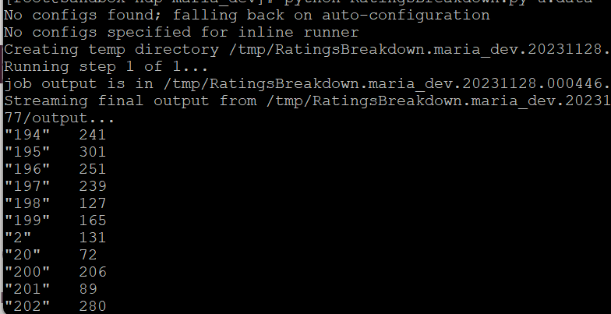
Mapper and Reducer
OUTPUT
def mapper_get_ratings(self, _, line): (userID, movieID, rating, timestamp) = line.split('\t') yield movieID, 1 def reducer_count_ratings(self, key, values): yield key, sum(values)

Slide 19
THANK YOU!
Any Questions?

